Slide 2
Call to Order- Lt. Gov. Ainsworth
Roll Call and Establishment of Quorum- Katanga Mants
Approval of prior meeting minutes
Approval of Agenda
Quarterly Meeting
November 18, 2020

Slide 3
E. Action Items
a. New Business
    Re-appointments
    Meeting schedule for 2021
      First Quarter- January 13, 2021
      Second Quarter- April 2021 in conjunction with AlabamaWorks! Conference
      Third Quarter- July 2021
      Fourth Quarter- November 2021 in conjunction with National Apprenticeship Week and state WBL summit.
Quarterly Meeting
November 18, 2020

Slide 4
Director’s Report
Programs Update
Apprentice Update
Tax Credit Update
Other AOA Projects and Grants

Slide 5
Programs Update

Slide 6
Programs Update- Prospective Programs

Slide 7
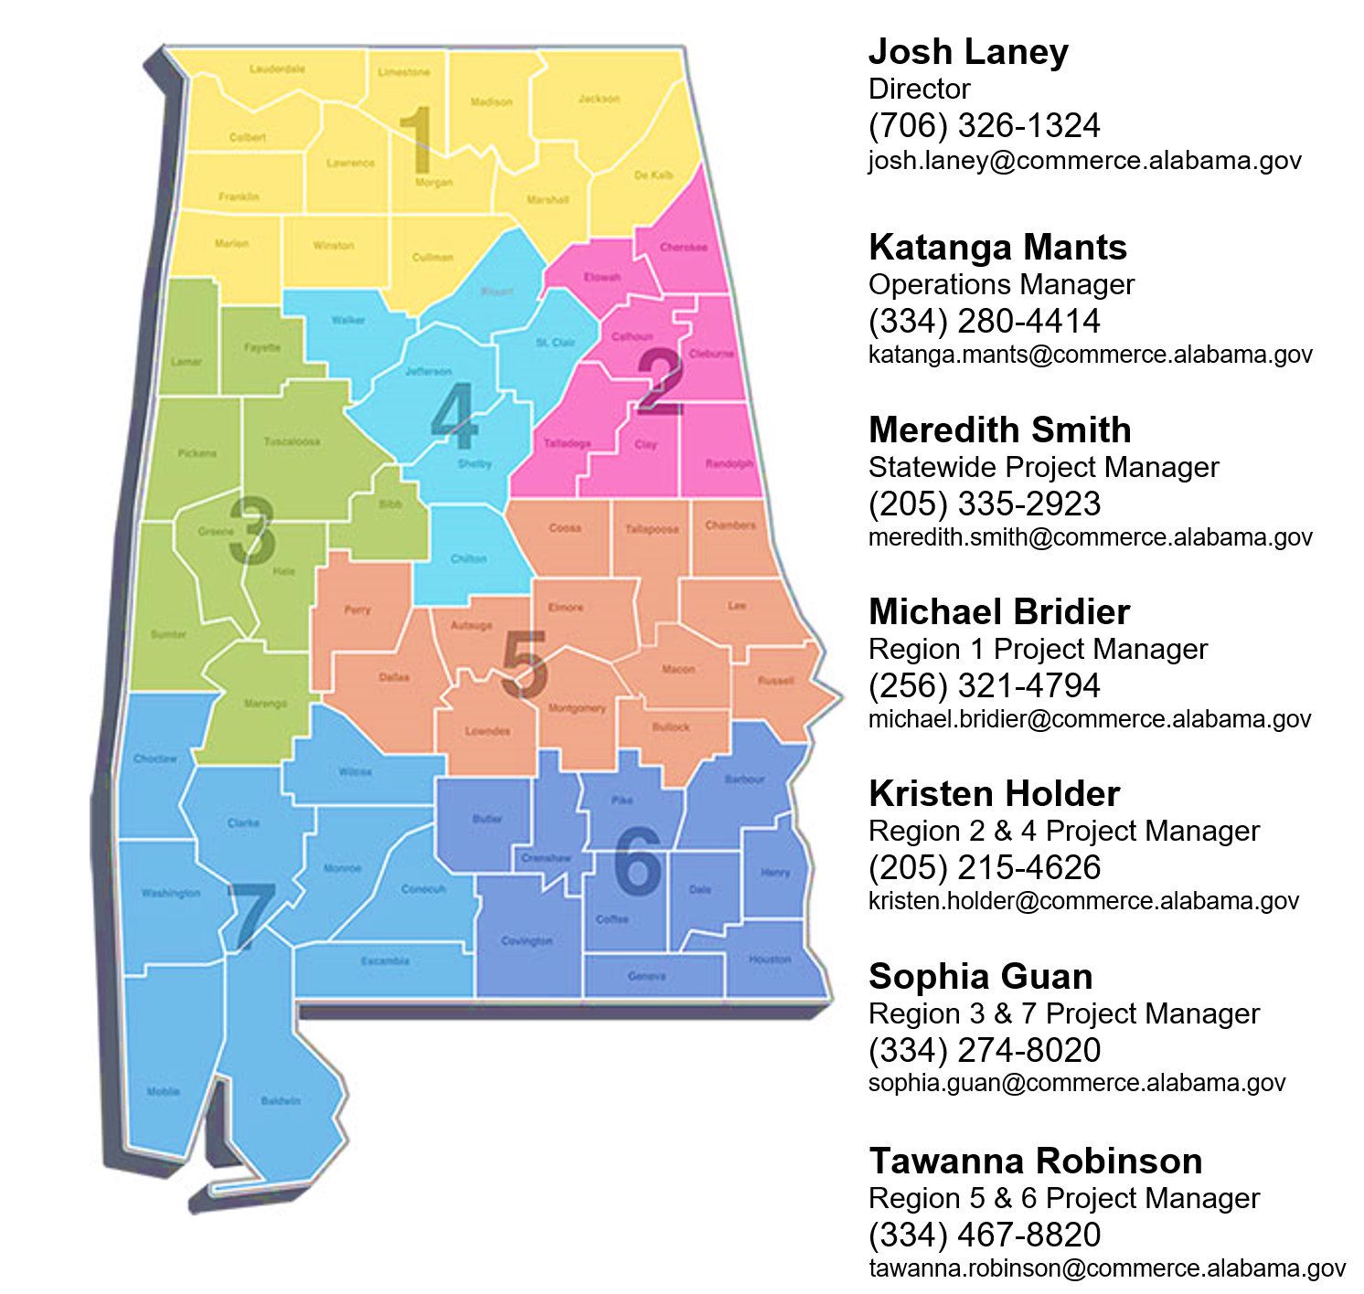
Programs Update- New Programs
Since July 1, 2020:
Bevill State Community College
  Welding
Associated Plumbing-Heating-Cooling Contractors of Alabama
  Plumber
  HVAC Mechanic
Calhoun Community College
  Industrial Maintenance

Slide 8
Programs Update- Active Programs
98 Programs have apprentices
Major data cleanup is still ongoing

Slide 9

Programs Update- Cancelled Programs
Cancelled Programs (16)
Cullman Electric
Lockheed Martin
State of Alabama Laborers
Diversified Services
Huntsville City Schools
Lee Price
EM&T
Steris – Birmingham
Fire PG
Hardie Tynes
Hager Hines
Leonard Peterson & Company
KHDM Construction
Rheem Water I & Rheem Water II
Dixie Tool & Die
Earl Gear
Suspended Programs (1)
Hamilton Ryker

Slide 10
Apprentice Updates

Slide 11
Apprentice Update- Active Apprentices
3,327 Active Apprentices

Slide 12

Apprentice Update- New Registrations
492 New apprentices since July 1, 2020
Average age is 28
Top 10 Occupations of New Apprentices
ELECTRICIAN | 199
CARPENTER | 70
SHEET METAL WORKER | 36
PIPE FITTER | 28
STRUCTURAL STEEL WORKER | 25
PIPEFITTING | 20
TRUCK DRIVER, HEAVY | 14
CARPENTER, INTERIOR SYSTEMS | 12
MILLWRIGHT | 11
PIPE COVERER & INSULATOR | 10

Slide 13

Apprentice Update- Completions
142 Apprentices have completed training since July 1, 2020
  Average time to completion 3 years 4 months
Top 10 Occupations of Completed Apprentices
MILLWRIGHT | 30
CARPENTER | 19
PIPE FITTER | 14
INDUSTRIAL MAINTENANCE MECHANIC | 13
PIPEFITTING | 12
ELECTRICIAN | 11
STRUCTURAL STEEL WORKER | 8
TRUCK DRIVER, HEAVY | 6
INDUSTRIAL MAINTENANCE REPAIRER | 6
OPERATING ENGINEER | 5

Slide 14

Apprentice Update- Cancellations

Slide 15
Tax Credit Updates

Slide 16
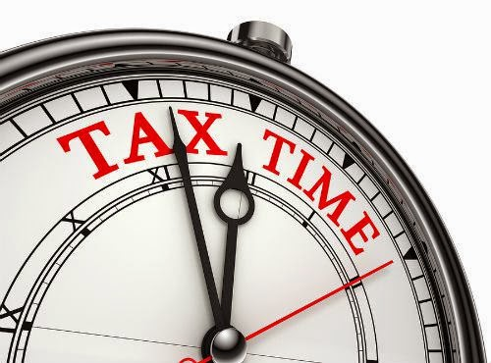
Tax Credit Update
Tax Year 2019
43 Employers
$160k in claims
160 Apprentices
3.7 Apprentices per employer average
Tax Year 2020
New application is online
15 Employers
$98,750 in claims
79 Apprentices
5.5 Apprentices per employer average
  6 employers claiming 9 or 10 apprentices

Slide 17
Other Projects and Grants

Slide 18

Other Projects and Grants- IRAP
Approved September 23rd.
  Manufacturing- Aligned with FAME occupations
    Industrial Machinery Mechanics
    Maintenance and Repair Workers
    Maintenance Workers, Machinery
Nationally, IRAPs are being viewed in a largely negative light. Federal administration changes drawing even more questions.
So far, no requests for consideration.
Work to be done to develop an SOP and training for the TAC if/when we get a request for review.

Slide 19
Other Projects and Grants- 2019 ASE Grant
$1.2 million total
Money for OJT reimbursements to employers has just begun to be rolled out.
  19 Newly registered programs have been identified and notified of their eligibility.
  17 Programs with expanded training have been identified and are being notified of eligibility.

Slide 20
Other Projects and Grants- 2020 ASE Grant
$450K
RFP is out through December 1 for ROI calculator
4 Apprenticeship sponsor trainings have been held
AOA staff has received training in EEO compliance (refer to policy memo)
Minor equipment purchases have been made to outfit regional offices

Slide 21
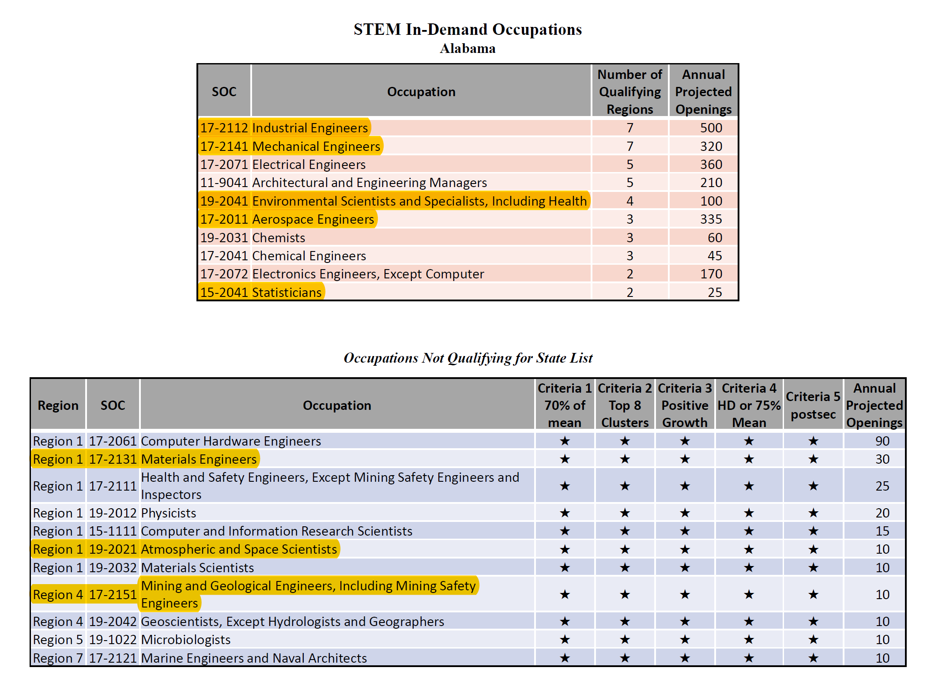
Other Projects and Grants-
Connection with STEM Council
Working with STEM Council to identify jobs that are:
In-Demand
Apprenticeable
STEM
Highlighted occupational codes this sample sheet contain one or more jobs that are apprenticeable.

Slide 22

Other Projects and Grants- NGA WBL Grant
First edition of WBL handbook has been released
  3500 copies being printed and distributed
  Banners for apprenticeship sponsors being printed
First webinar for WBL practitioners has been held
  Second is set for 2:00 pm December 8th
  Watch prior and register for next at www.AlabamaWorks.com
Grant activities for 2021
  Continue trainings and resources from year 1
  Host a multi-state WBL conference in November, 2021

Slide 23
G. Discussion Items
a. Ratio Policy
b. Employer Investment Policy
H. Information Items for Upcoming Meeting
a. Next meeting January 13, 2:00PM (Format TBD)
b. Annual report to legislature will be submitted February 1 and will be shared with the council immediately after delivery.
I. Adjournment
Quarterly Meeting
November 18, 2020

