Slide 2
Basics of Registered Apprenticeship

Slide 3
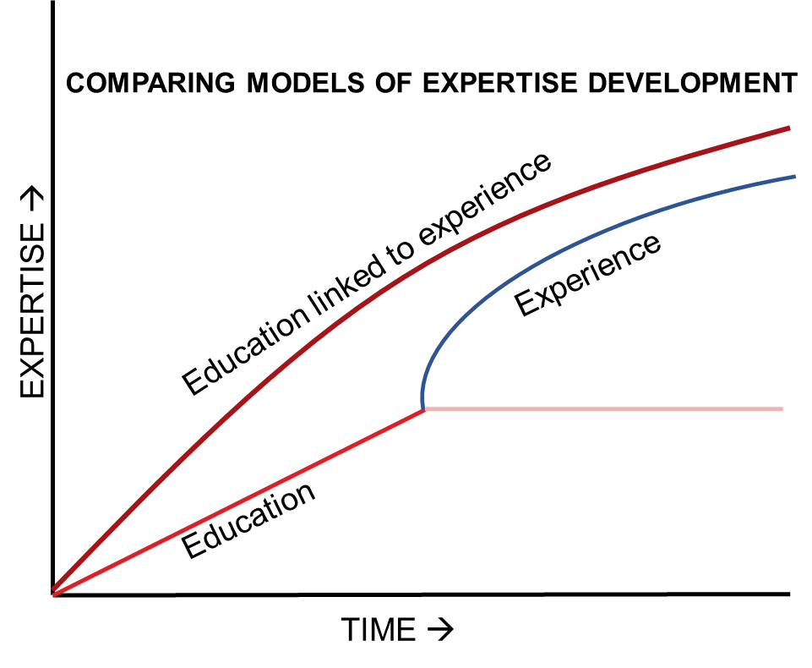
What exactly is an apprenticeship?
5 components:
Industry-driven
On-the-Job Training
Related Instruction
Progressive Wages
National Credentials

Slide 4
Apprenticeship builds employer workforce infrastructure.
It’s about talent pipeline management.
Youth populations
Engaging youth in RAs and pre-RA training can increase the long-term workforce pipeline.
New adult workers
RAs serve as excellent recruiting tools by laying out a clear career progression.
Incumbent workers
RAs provide a way to take your best employees to their highest potential.
Seasoned workers
Highly-skilled workers take pride in training the next generation and sometimes stay longer just for that purpose.

Slide 5
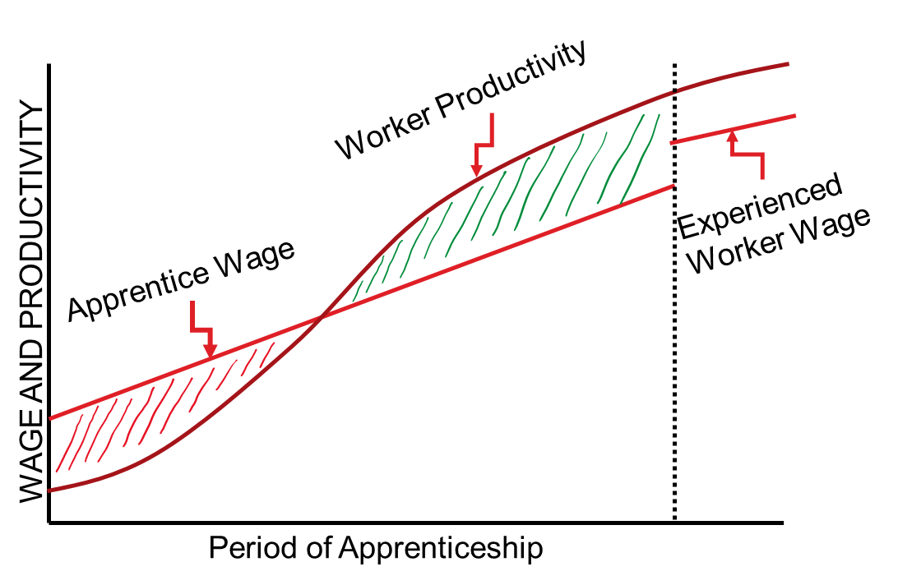
Apprenticeships provide excellent ROI.
Every new hire has recruitment costs.
Every new hire has onboarding costs.
Every new hire has wages.
With apprenticeships, the employer investment is the cost of training.

Slide 6

Alabama Office of Apprenticeship
Establishment and organization
Developing metrics
Ongoing initiatives
Upcoming activities

Slide 7
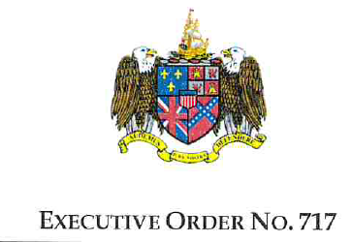
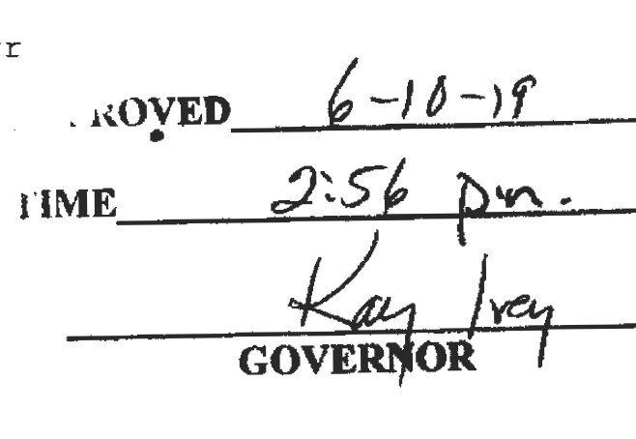
Establishment and Organization
New office established by Executive Order 717 and legislative action Act 2019-506
Organized as a workforce activity of the Department of Commerce, incubated and supported through AIDT

Slide 8
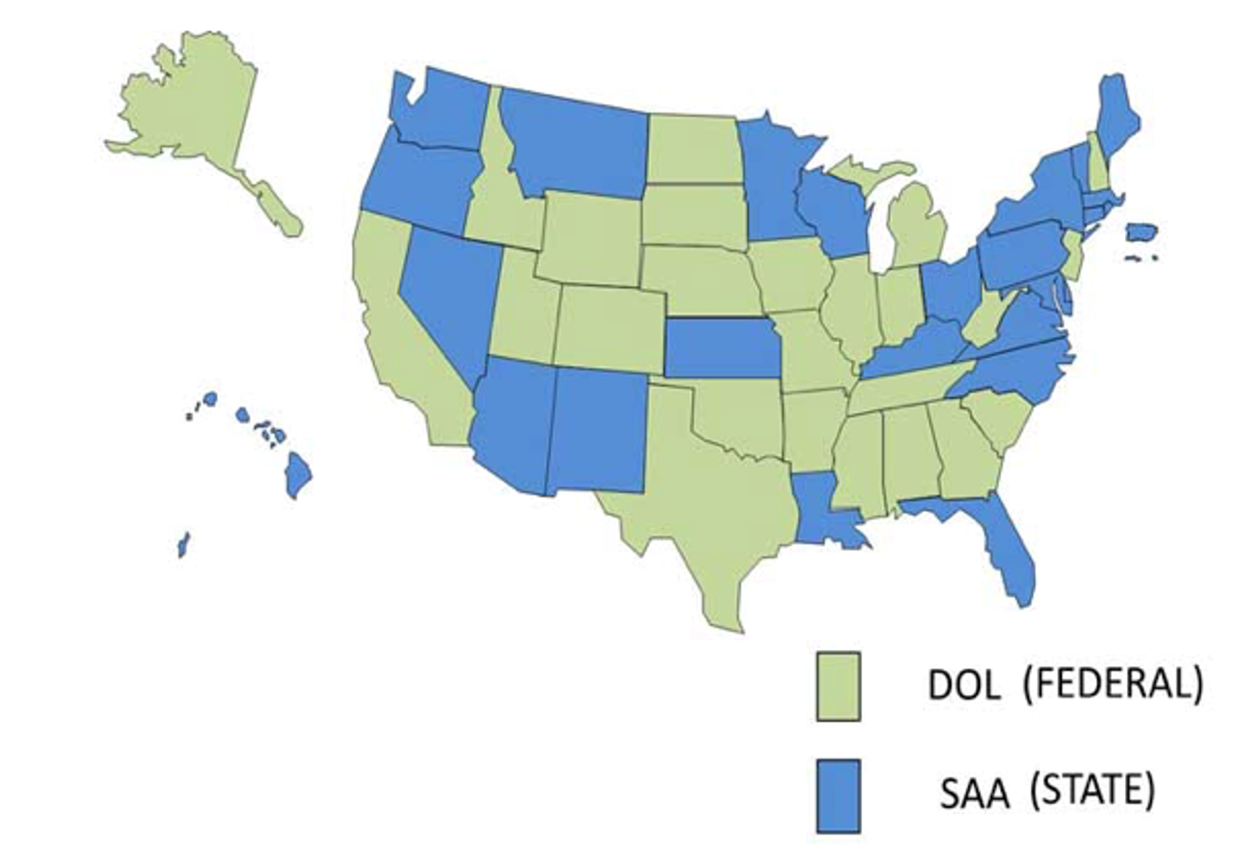
Establishment and Organization
Alabama will be designated an SAA state. (Estimated March ’20)
The AOA will assume responsibilities from USDOL for
  Promotion
  Registration
  Technical Assistance
  Monitoring
Note: RAs established through AOA are still USDOL recognized and nationally portable.

Slide 9

Establishment and Organization
Four Ways the AOA Will Better Serve AL
Improve flexibility and customer service for employers
Develop flexible new apprenticeship models
Grow the variety of occupations being trained
Increase diversity of Alabamians becoming apprentices

Slide 10

Developing Metrics
The AOA’s contribution will be measured by:
  Employers served/programs created
  New apprentices in training
Individual RAs will be judged on completion and retention rates, among other characteristics.
Adding 500,000 new certified skilled workers by 2025

Slide 11

Developing Metrics
Specific growth targets are impossible to set based on current data which is incomplete and inaccurate.
  107 active sponsors
    Austal listed 4 times
  74 employers
    Impossible to have fewer employers than sponsors
  4,525 apprentices listed
    928 listed under one sponsor registered in Virginia
AOA will spend significant time and resources cleaning up data upon SAA approval.

Slide 12
Ongoing Activities
AOA helps employers chart a path to the training program that is right for them.
PLAN
AOA meets with employer to discuss RA programs.
DRAFT
AOA develops draft program Standards to USDOL and Company.
REVIEW
Program Standards are reviewed and signed when a consensus is reached by all parties.
LAUNCH
Upon approval, company, stakeholders and partners implement RA program.
REGISTER
AOA sends signed standards for approval at the USDOL regional office.

Slide 13
Ongoing Activities
Continuing to work with the USDOL to promote and expand Registered Apprenticeship (RA)
Creating new sponsor consortia and signing on new employers

Slide 14

Ongoing Activities
Administering 2019 tax credits with simplified process
  24 employers have already applied and been approved
  $93,000 in credit vouchers already issued
    (71% of the 2018 total)
  Average number of eligible apprentices claimed per employer is 3.875
  58% of employers claimed the maximum
  21% of employers claimed 1 apprentice
Increases in 2020
  2020 increase per apprentice ($1250)
  2020 increase total available (10)
  2020 new benefit for youth apprentices ($500)

Slide 15
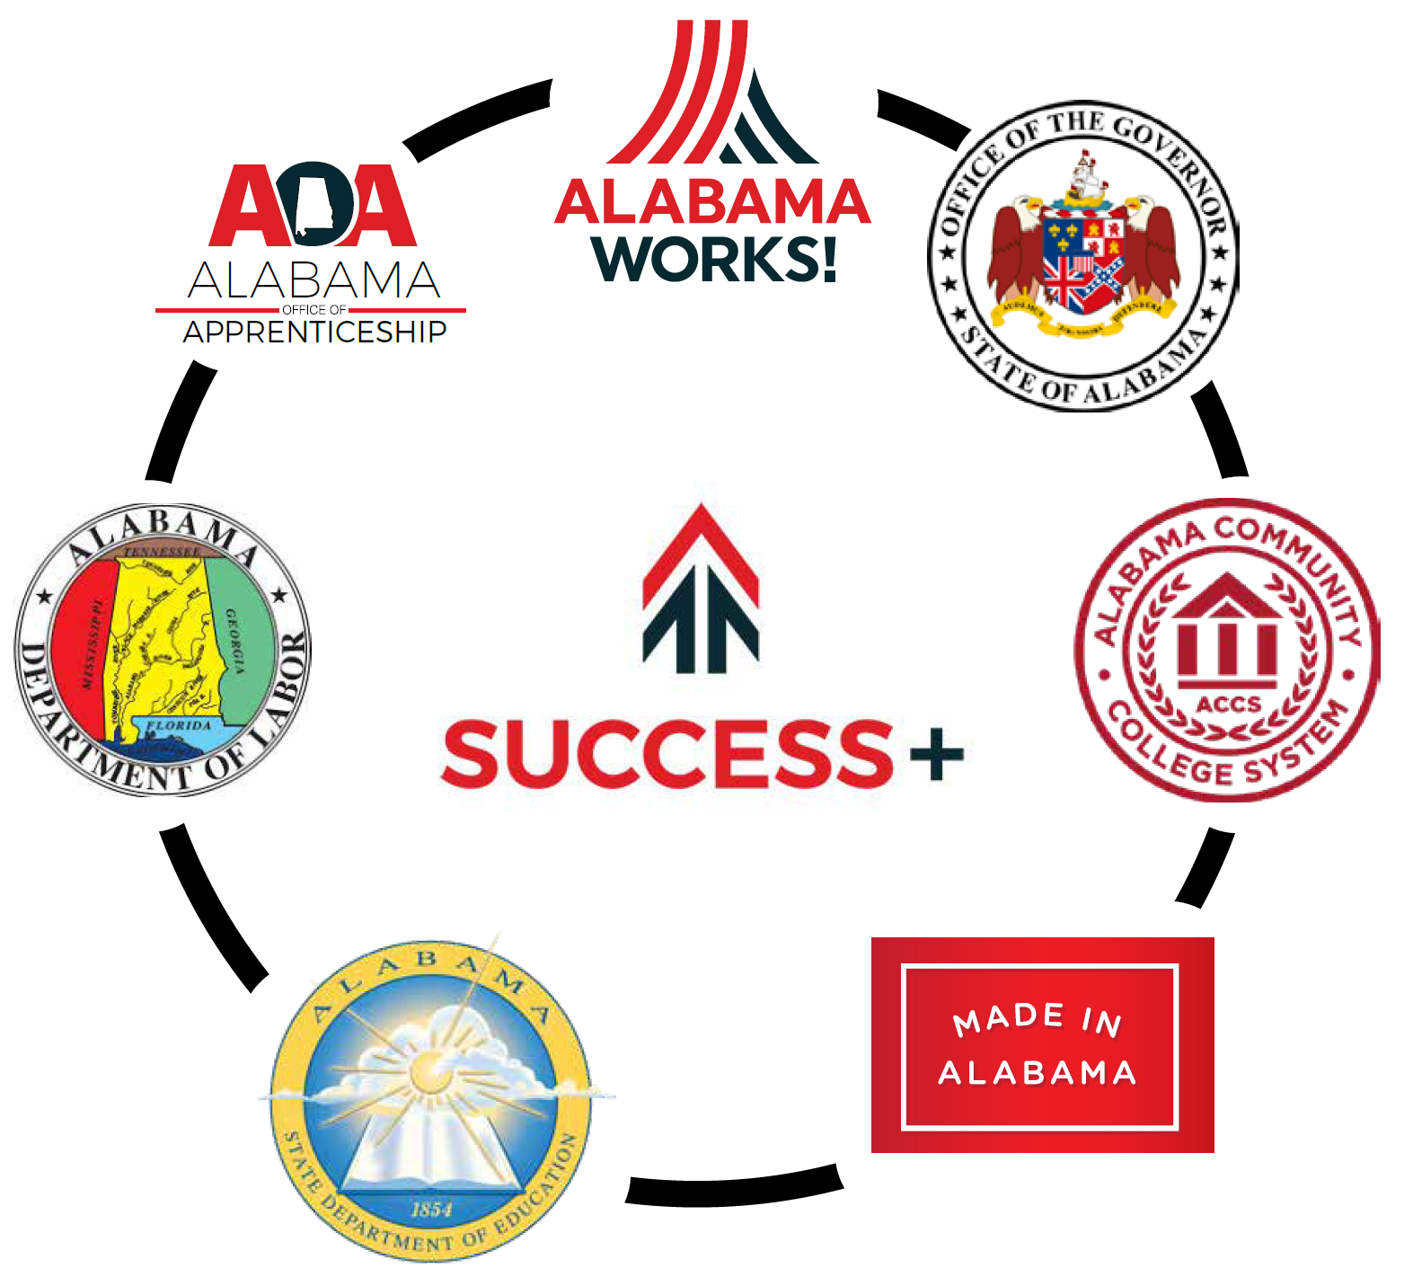
Upcoming Activities
Connecting resources
SAE grant providing funding to assist employers with OJT
Supplemental source to WIOA OJT
Braiding with state dollars to provide RTI cost offsets with ACCS

Slide 16
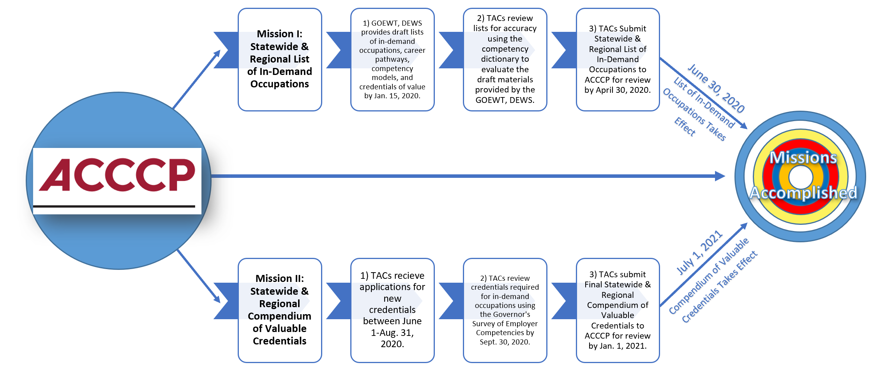
Upcoming Activities
Competency model development

Slide 17
Program Registrations, Suspensions, and De-Registrations

Slide 18


Josh Laney
706-326-1324
@LaneyWorks
www.alapprentice.org
Josh.Laney@Commerce.Alabama.gov

