Slide 2
Call to Order- Ed Castile
Roll Call and Establishment of Quorum- Katanga Mants
Approval of prior meeting minutes (January minutes. April meeting was cancelled.)
Approval of Agenda
Quarterly Meeting
July 8, 2020

Slide 3
E. Action Items
a. Old Business
    Vote on Selection of Council Vice-Chair
    Vote on Selection of Council Pro-Tempore
Quarterly Meeting
July 8, 2020

Slide 4
Director’s Report
Introductions of AOA Staff
Programs Update
Apprentice Update
Tax Credit Update
Other AOA Projects and Grants

Slide 5
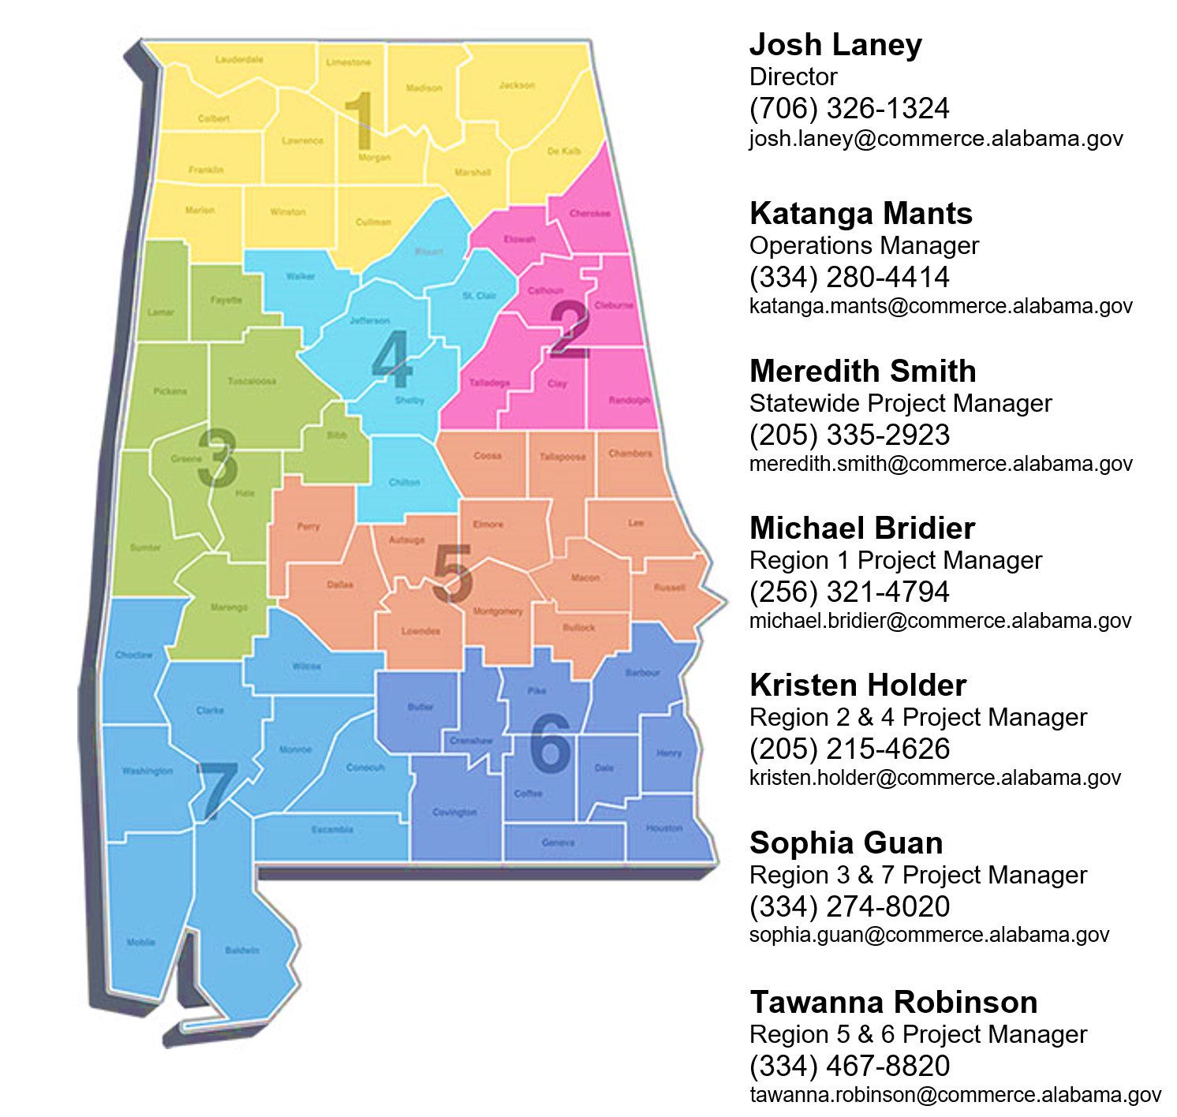
www.alapprentice.org/contact/

Slide 6
Programs Update

Slide 7
Programs Update- Prospective Programs

Slide 8
Programs Update- New Programs
Since August 1, 2019:
14 New sponsors registered
  8 Community Colleges
  1 University
  1 K-12 System
  2 Single Employer
  2 Employer Consortia
23 Occupations registered
  4 Construction
  1 Child Care
  1 Finance
  1 Healthcare
  2 Information Technology
  10 Manufacturing
  1 Military
  3 Transportation

Slide 9
Programs Update- Active Programs
102 Programs have apprentices
Some programs were established and have been paused due to COVID
Major data cleanup is ongoing
Still several programs with duplicate entries

Slide 10
Programs Update- Cancelled Programs
Only voluntary cancellations have been done so far.
  EM&T
  Northeast Alabama Apprenticeship Program
  STERIS
Cancellation process with inactive programs will begin soon.
  10-12 Programs may get letters.

Slide 11
Apprentice Updates

Slide 12
Apprentice Update- Active Apprentices
3,362 Active Apprentices

Slide 13

Apprentice Update- New Registrations
1087 New apprentices in 49 occupations since August 1, 2019
  Average age is 28
Top 10 Occupations of New Apprentices
INTERIOR ELECTRICIAN | 341
CARPENTER | 130
STRUCTURAL STEEL WORKER | 87
SHEET METAL WORKER | 61
PIPE FITTER (Construction) | 56
MILLWRIGHT | 44
TRUCK DRIVER, HEAVY | 36
FABRICATOR-ASSEMBLER METAL PROD | 31
PIPE COVERER & INSULATOR | 31
OPERATING ENGINEER | 20

Slide 14

Apprentice Update- Completions
398 Apprentices have completed training since August 1, 2019
  Average time to completion 3 years 4 months
Top 10 Occupations of Completed Apprentices
INTERIOR ELECTRICIAN | 104
CARPENTER | 57
MILLWRIGHT | 45
PIPEFITTING | 37
PIPE FITTER (CONSTRUCTION) | 35
STRUCTURAL STEEL WORKER | 34
TRUCK DRIVER, HEAVY | 29
PRECISION MACHINIST | 17
COMPOSITE PLASTIC FABRICATOR | 9
TOOL AND DIE MAKER | 7

Slide 15

Apprentice Update- Cancellations

Slide 16
Tax Credit Updates

Slide 17

Tax Credit Update
Tax Year 2019
40 Employers
$146k in claims
146 Apprentices
3.7 Apprentices per employer average

Slide 18
Other Projects and Grants

Slide 19

Other Projects and Grants- IRAP
June 11- Application was submitted for the AOA to be a Standards Recognition Entity (SRE) for:
  Manufacturing- Aligned with FAME occupations
    Industrial Machinery Mechanics
    Maintenance and Repair Workers
    Maintenance Workers, Machinery
Response expected in late August
Nationally, IRAPs are being viewed in a largely negative light.

Slide 20

Other Projects and Grants- NGA WBL Grant
Alabama is a mentor state for WBL Policy Academy
Grant activities for 2020:
  Conduct regional WBL trainings in partnership with ACCS, ALSDE, and ACHE
  Identify best-practice models of WBL and promote for scalability
  Develop a WBL manual with definitions, contact information, best-practice sites, and resources
Grant activities for 2021
  Continue trainings and resources from year 1
  Host a multi-state WBL conference in November, 2021

Slide 21
Other Projects and Grants- 2019 ASE Grant
$1.2 million
Funding research on in-demand occupations and competency model development with the ACCCP
Funding an “apprenticeship module” to capture data and integrate with WIOA and other services
Money for OJT reimbursements to employers has been virtually impossible to spend.

Slide 22
Other Projects and Grants- 2020 ASE Grant
$450K
Develop a web-based return on investment calculator
Develop training for apprenticeship sponsors and mentors
Provide professional development for AOA staff
Provide resources to outfit regional offices

Slide 23
Other Projects and Grants-
Pre-Apprenticeship Certification
Goals
Build connections between WBL programs and sponsors of RAs.
Provide quality assurance.
Ensure portability of training.
Characteristics
Training aligned with skill needs of employers in the State
Access to educational and career counseling and other supportive services
Hands-on, meaningful learning activities and understanding how the skills acquired through coursework can be applied toward a future career
Opportunities to attain at least one industry-recognized credential*
A partnership with one or more RA programs

Slide 24


Josh Laney
706-326-1324
@LaneyWorks
www.alapprentice.org
Josh.Laney@Commerce.Alabama.gov

Slide 25
Quarterly Meeting
July 8, 2020
G. Information for Upcoming Meeting
a. Next meeting November 18th, 2:00PM (Virtual, in-person, or mixed delivery TBD)
a. Reappointments for 3 council positions
H. Adjournment

